Slide 1
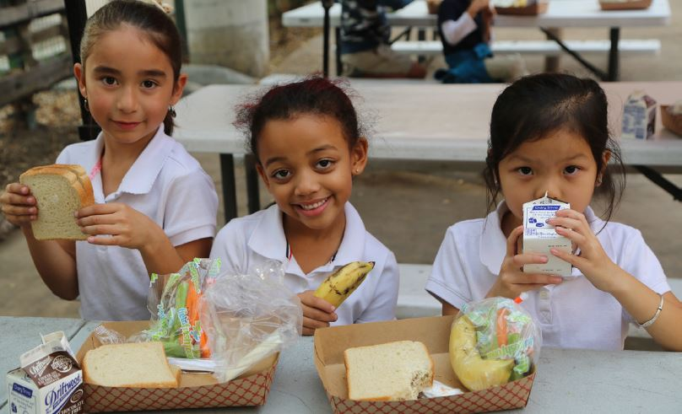
Food from the Bar
NCWBA Webinar
November 28, 2018

Slide 2
National Conference of Women’s Bar Associations
What is Food from the Bar?
Food from the Bar is an anti-hunger campaign organized by individual legal communities to support their local food banks.
Financial Donations
Food Donations
Volunteer Hours
“Friendly competition” makes it work (and makes it fun)

Slide 3
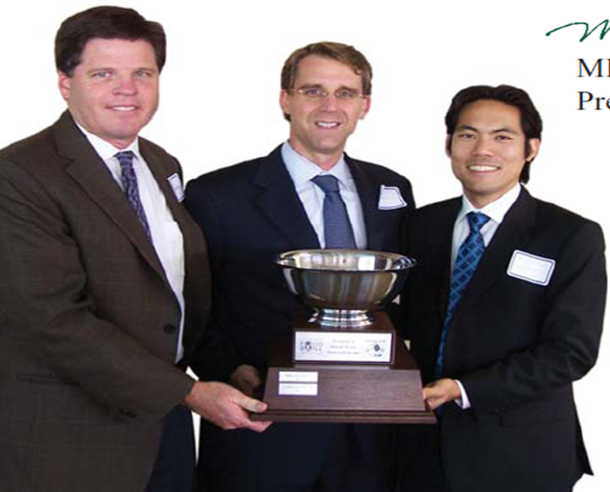
National Conference of Women’s Bar Associations
How the FFTB Competition Works
Healthy Competition
    $1 = 1 point
    5 lbs food = 1 point
    Volunteer shift = 20 points
    Multi-week campaign
    Awards
    Per Capita
    Creativity Award
    Cornucopia

Slide 4
Why Food from the Bar?

Slide 5
National Conference of Women’s Bar Associations
In 2017, 1 in 8 Americans were food insecure.
Over 12 million of those are children

Slide 6
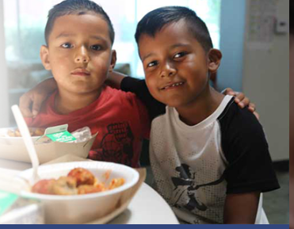
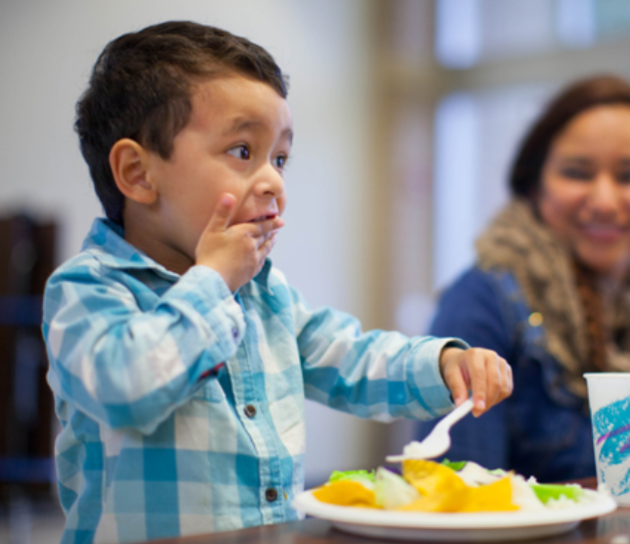

National Conference of Women’s Bar Associations
The Faces of Childhood Hunger

Slide 7


National Conference of Women’s Bar Associations
In 2016, 30.4 million children participated in the National School Lunch Program.
During summer vacation, these students often lose reliable access to this food source.

Slide 8
National Conference of Women’s Bar Associations
Why Spring?
Most Food from the Bar programs run for about four weeks during the Spring
This program bolsters Food Banks’ stores before the summer rush.

Slide 9
How did Food from the Bar get Started?

Slide 10
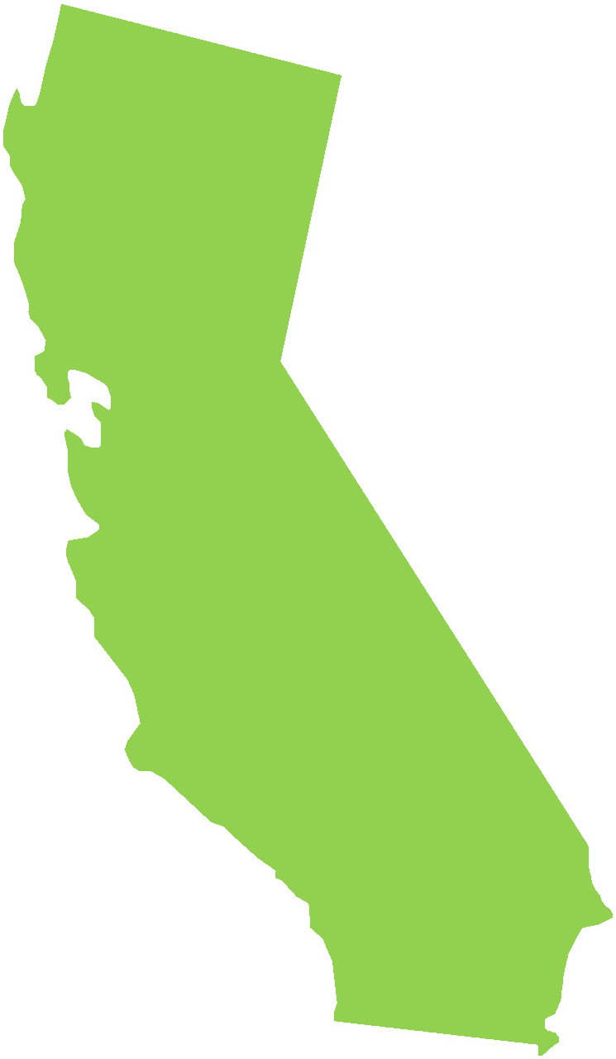



National Conference of Women’s Bar Associations
Food from the Bar started in
Northern California 20+ years ago
.
San Francisco-Marin Food Bank
Food Bank of Contra Costa & Solano
.

Slide 11


National Conference of Women’s Bar Associations
In 2009, Los Angeles started its own FFTB program.
.
.
.

Slide 12


National Conference of Women’s Bar Associations
Santa Barbara took up the cause in 2010
.
.
San Diego began its FFTB campaign in 2012
.
.

Slide 13
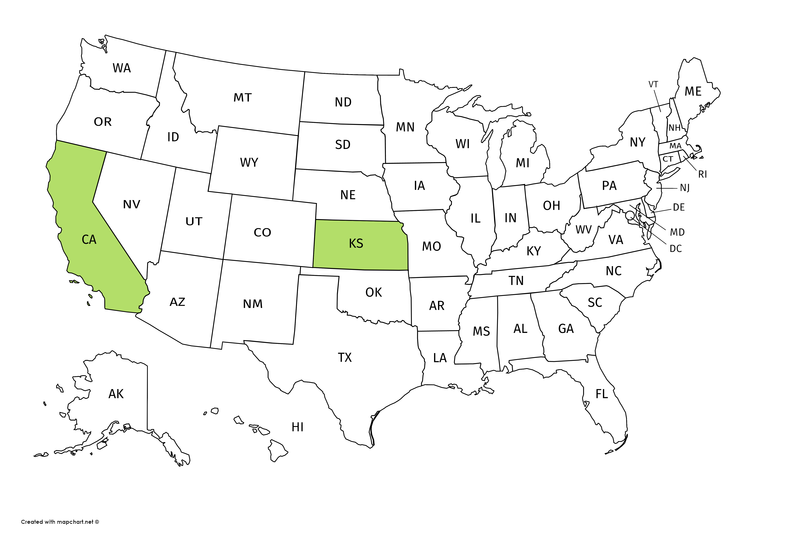


National Conference of Women’s Bar Associations
It started in
Northern California
In 2011, the Food from the Bar program went national
Kansas joined California as the second state.

Slide 14
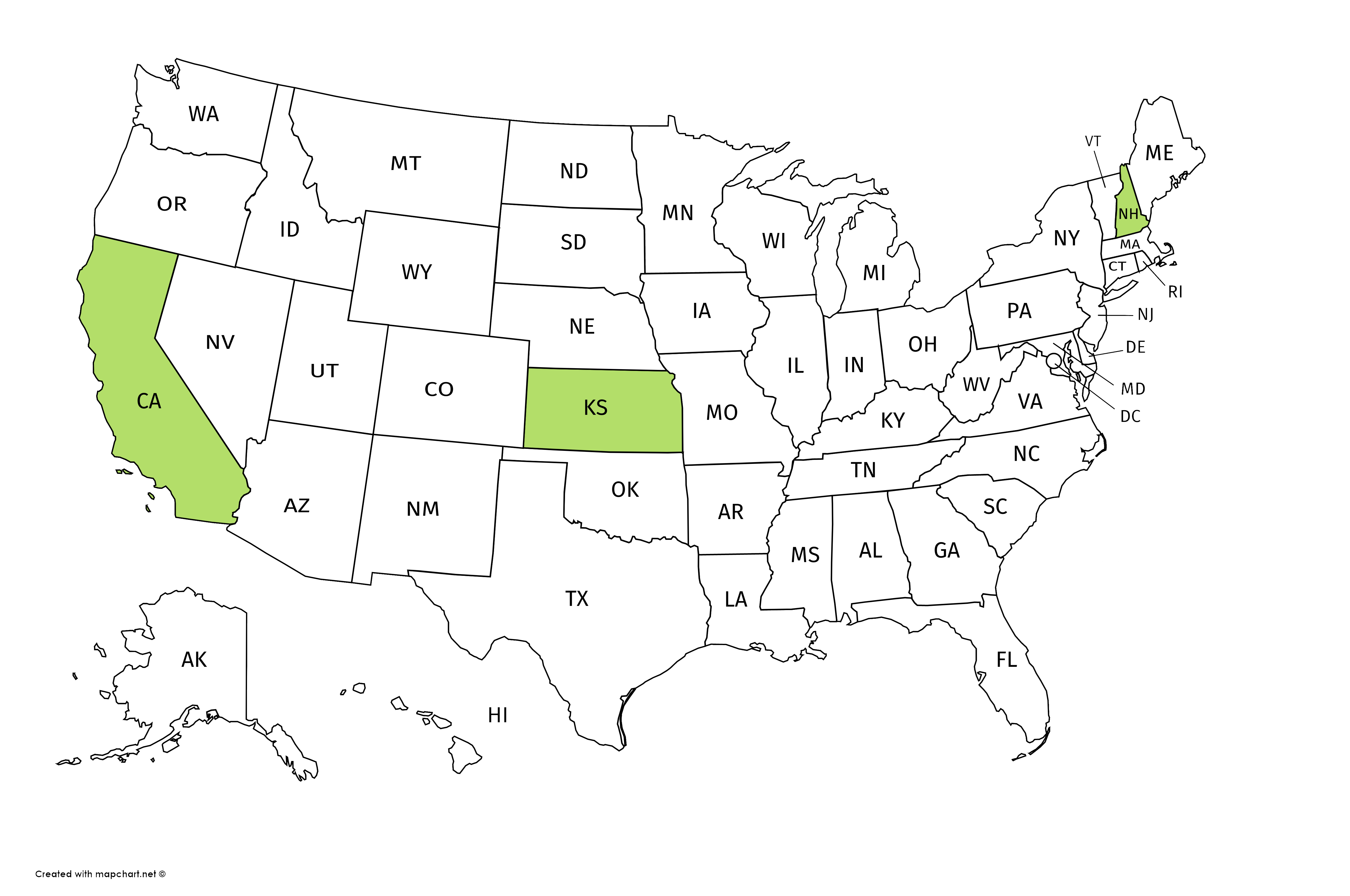

National Conference of Women’s Bar Associations
New Hampshire followed shortly after.

Slide 15
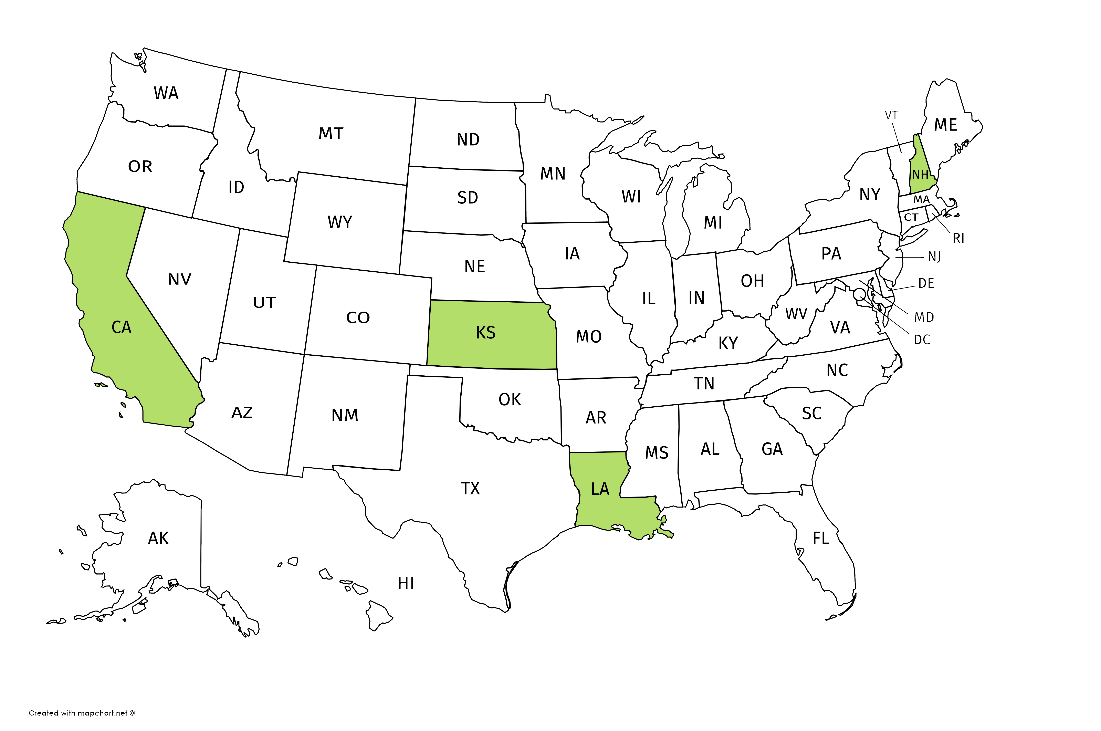

National Conference of Women’s Bar Associations
New Orleans added another state in 2012.

Slide 16
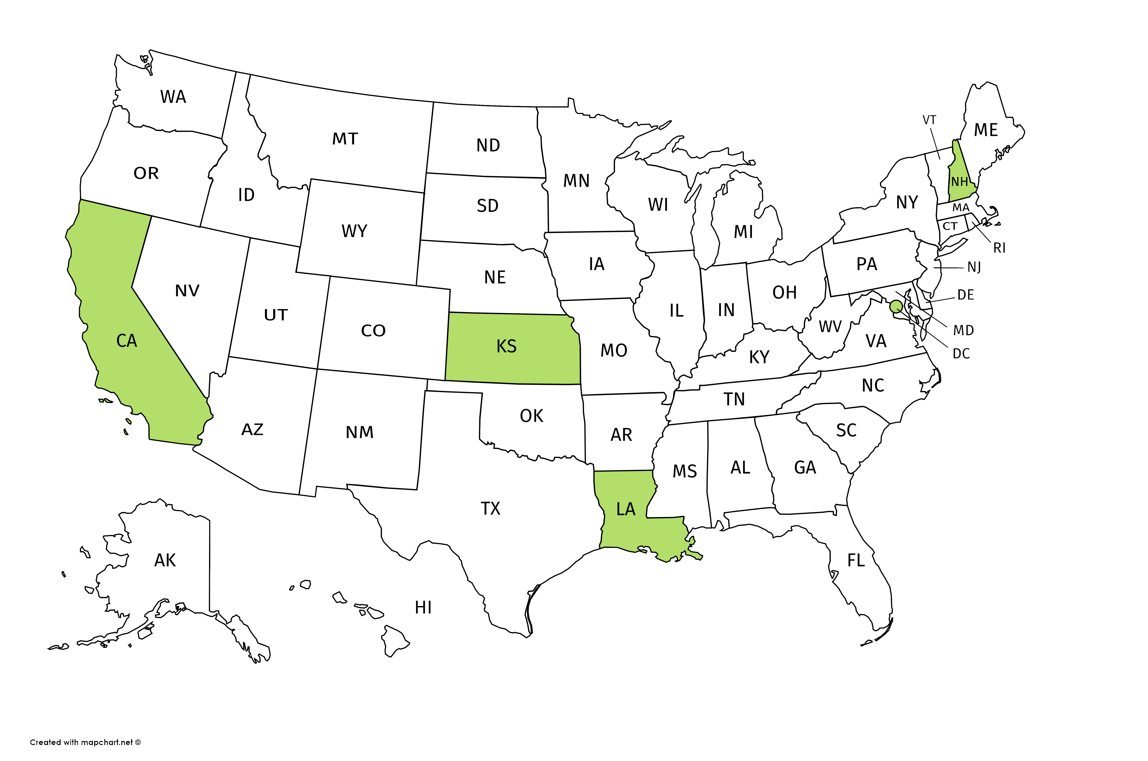


National Conference of Women’s Bar Associations
Washington DC incorporated Food from the Bar into a pre-existing program in 2014.

Slide 17
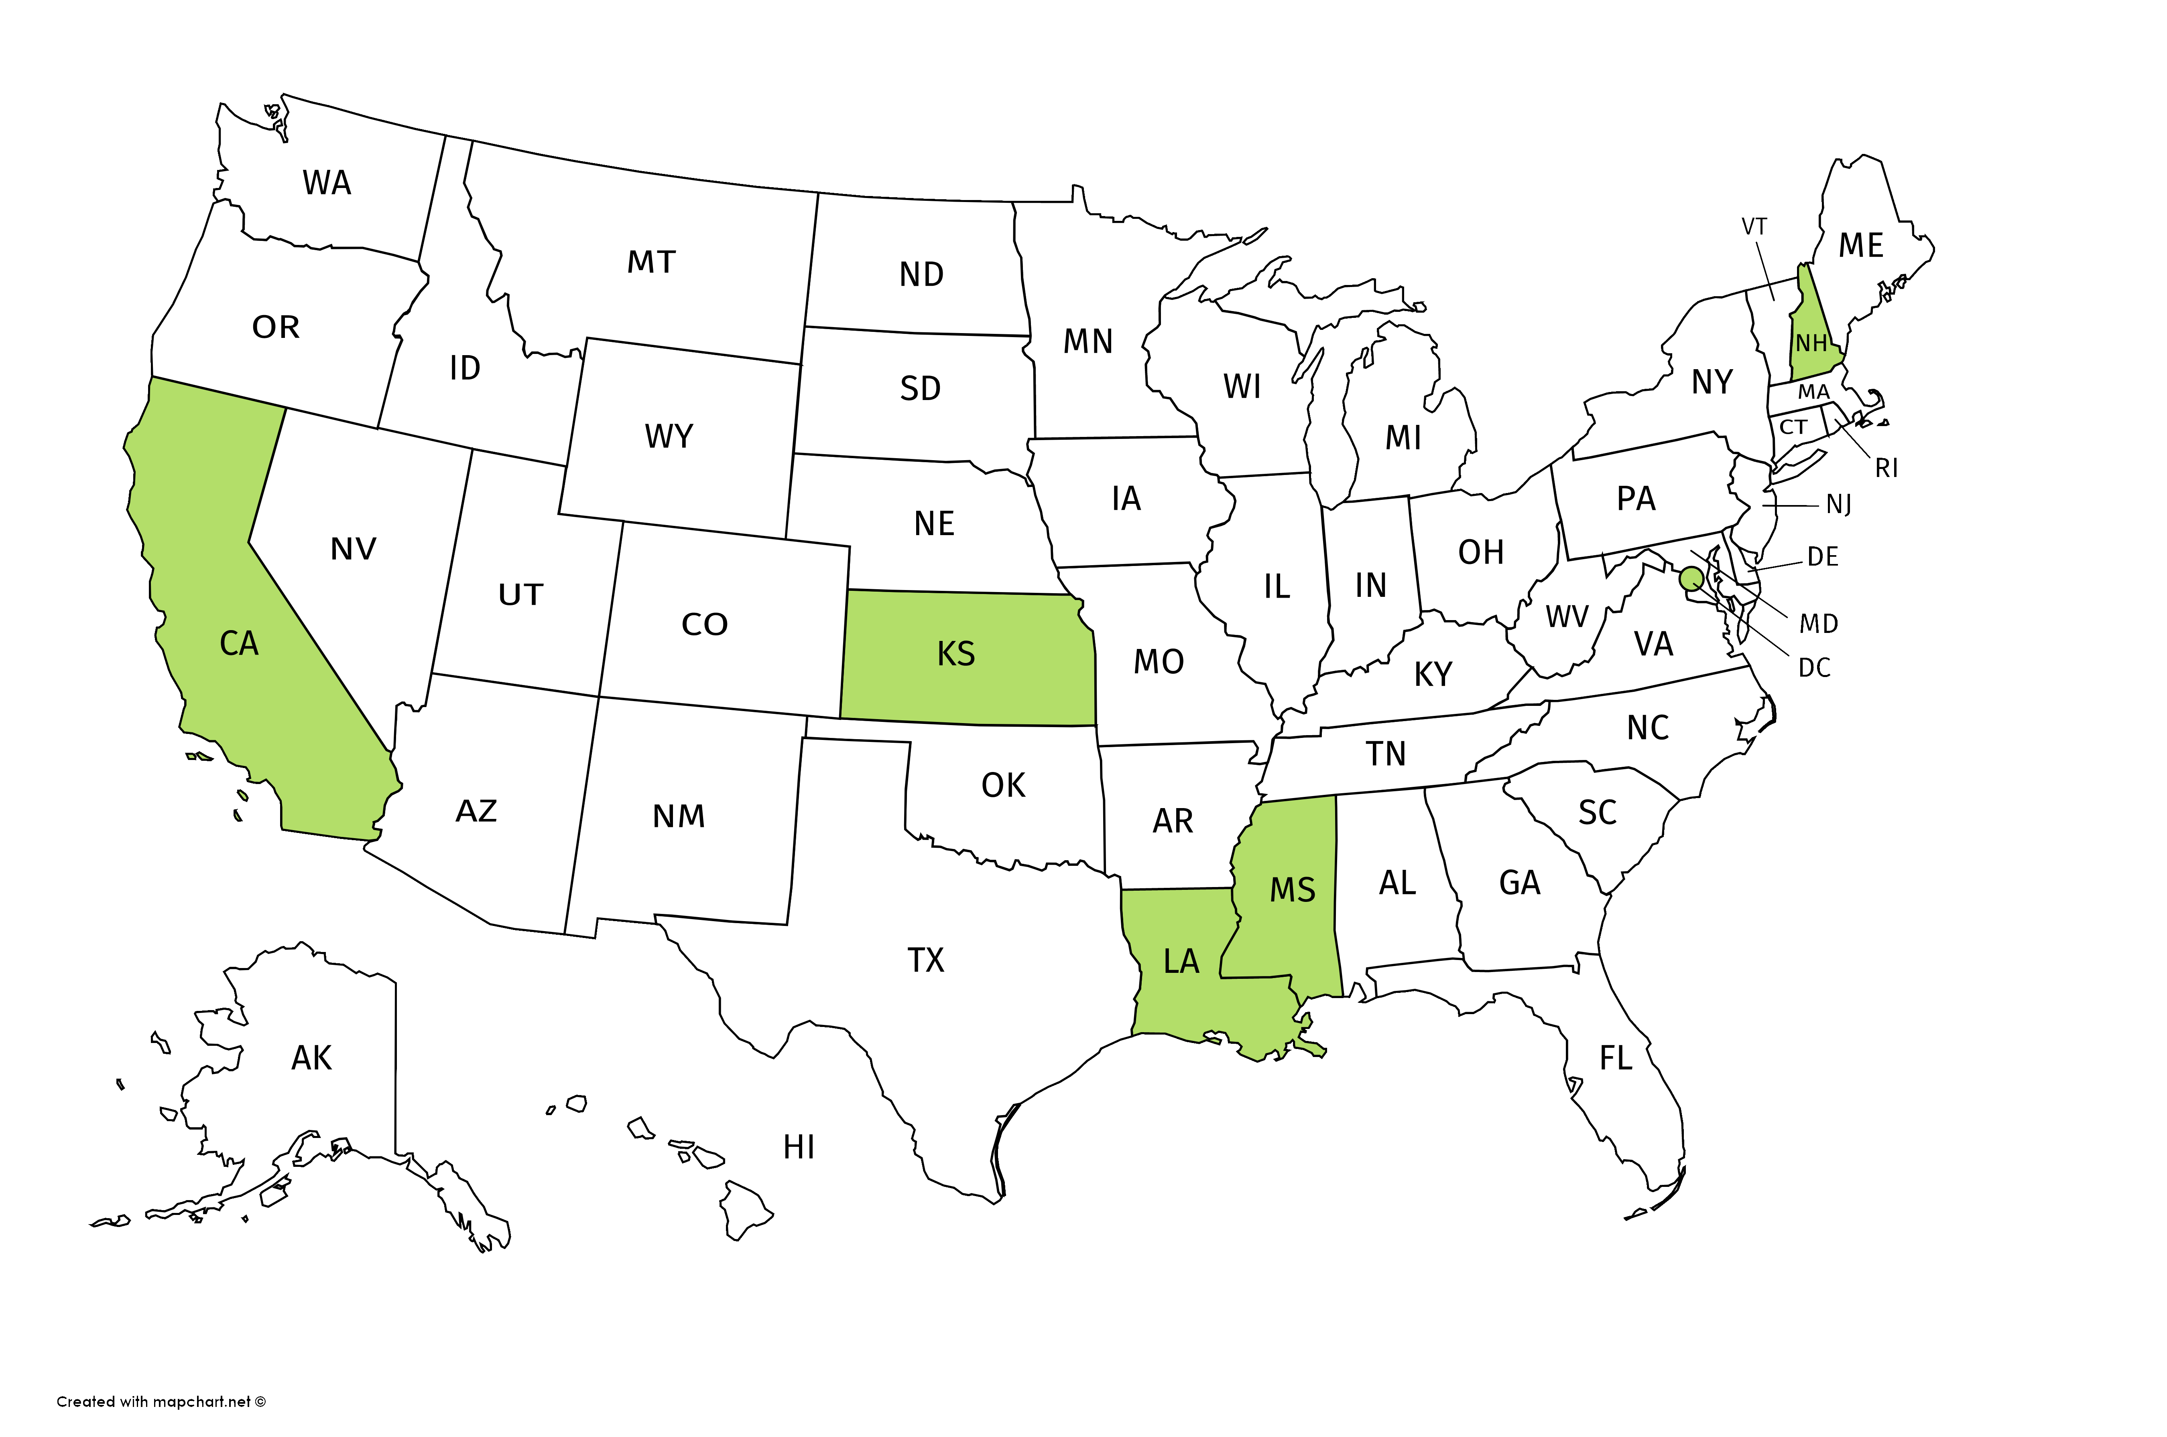

National Conference of Women’s Bar Associations
Mississippi started its program in 2015.

Slide 18
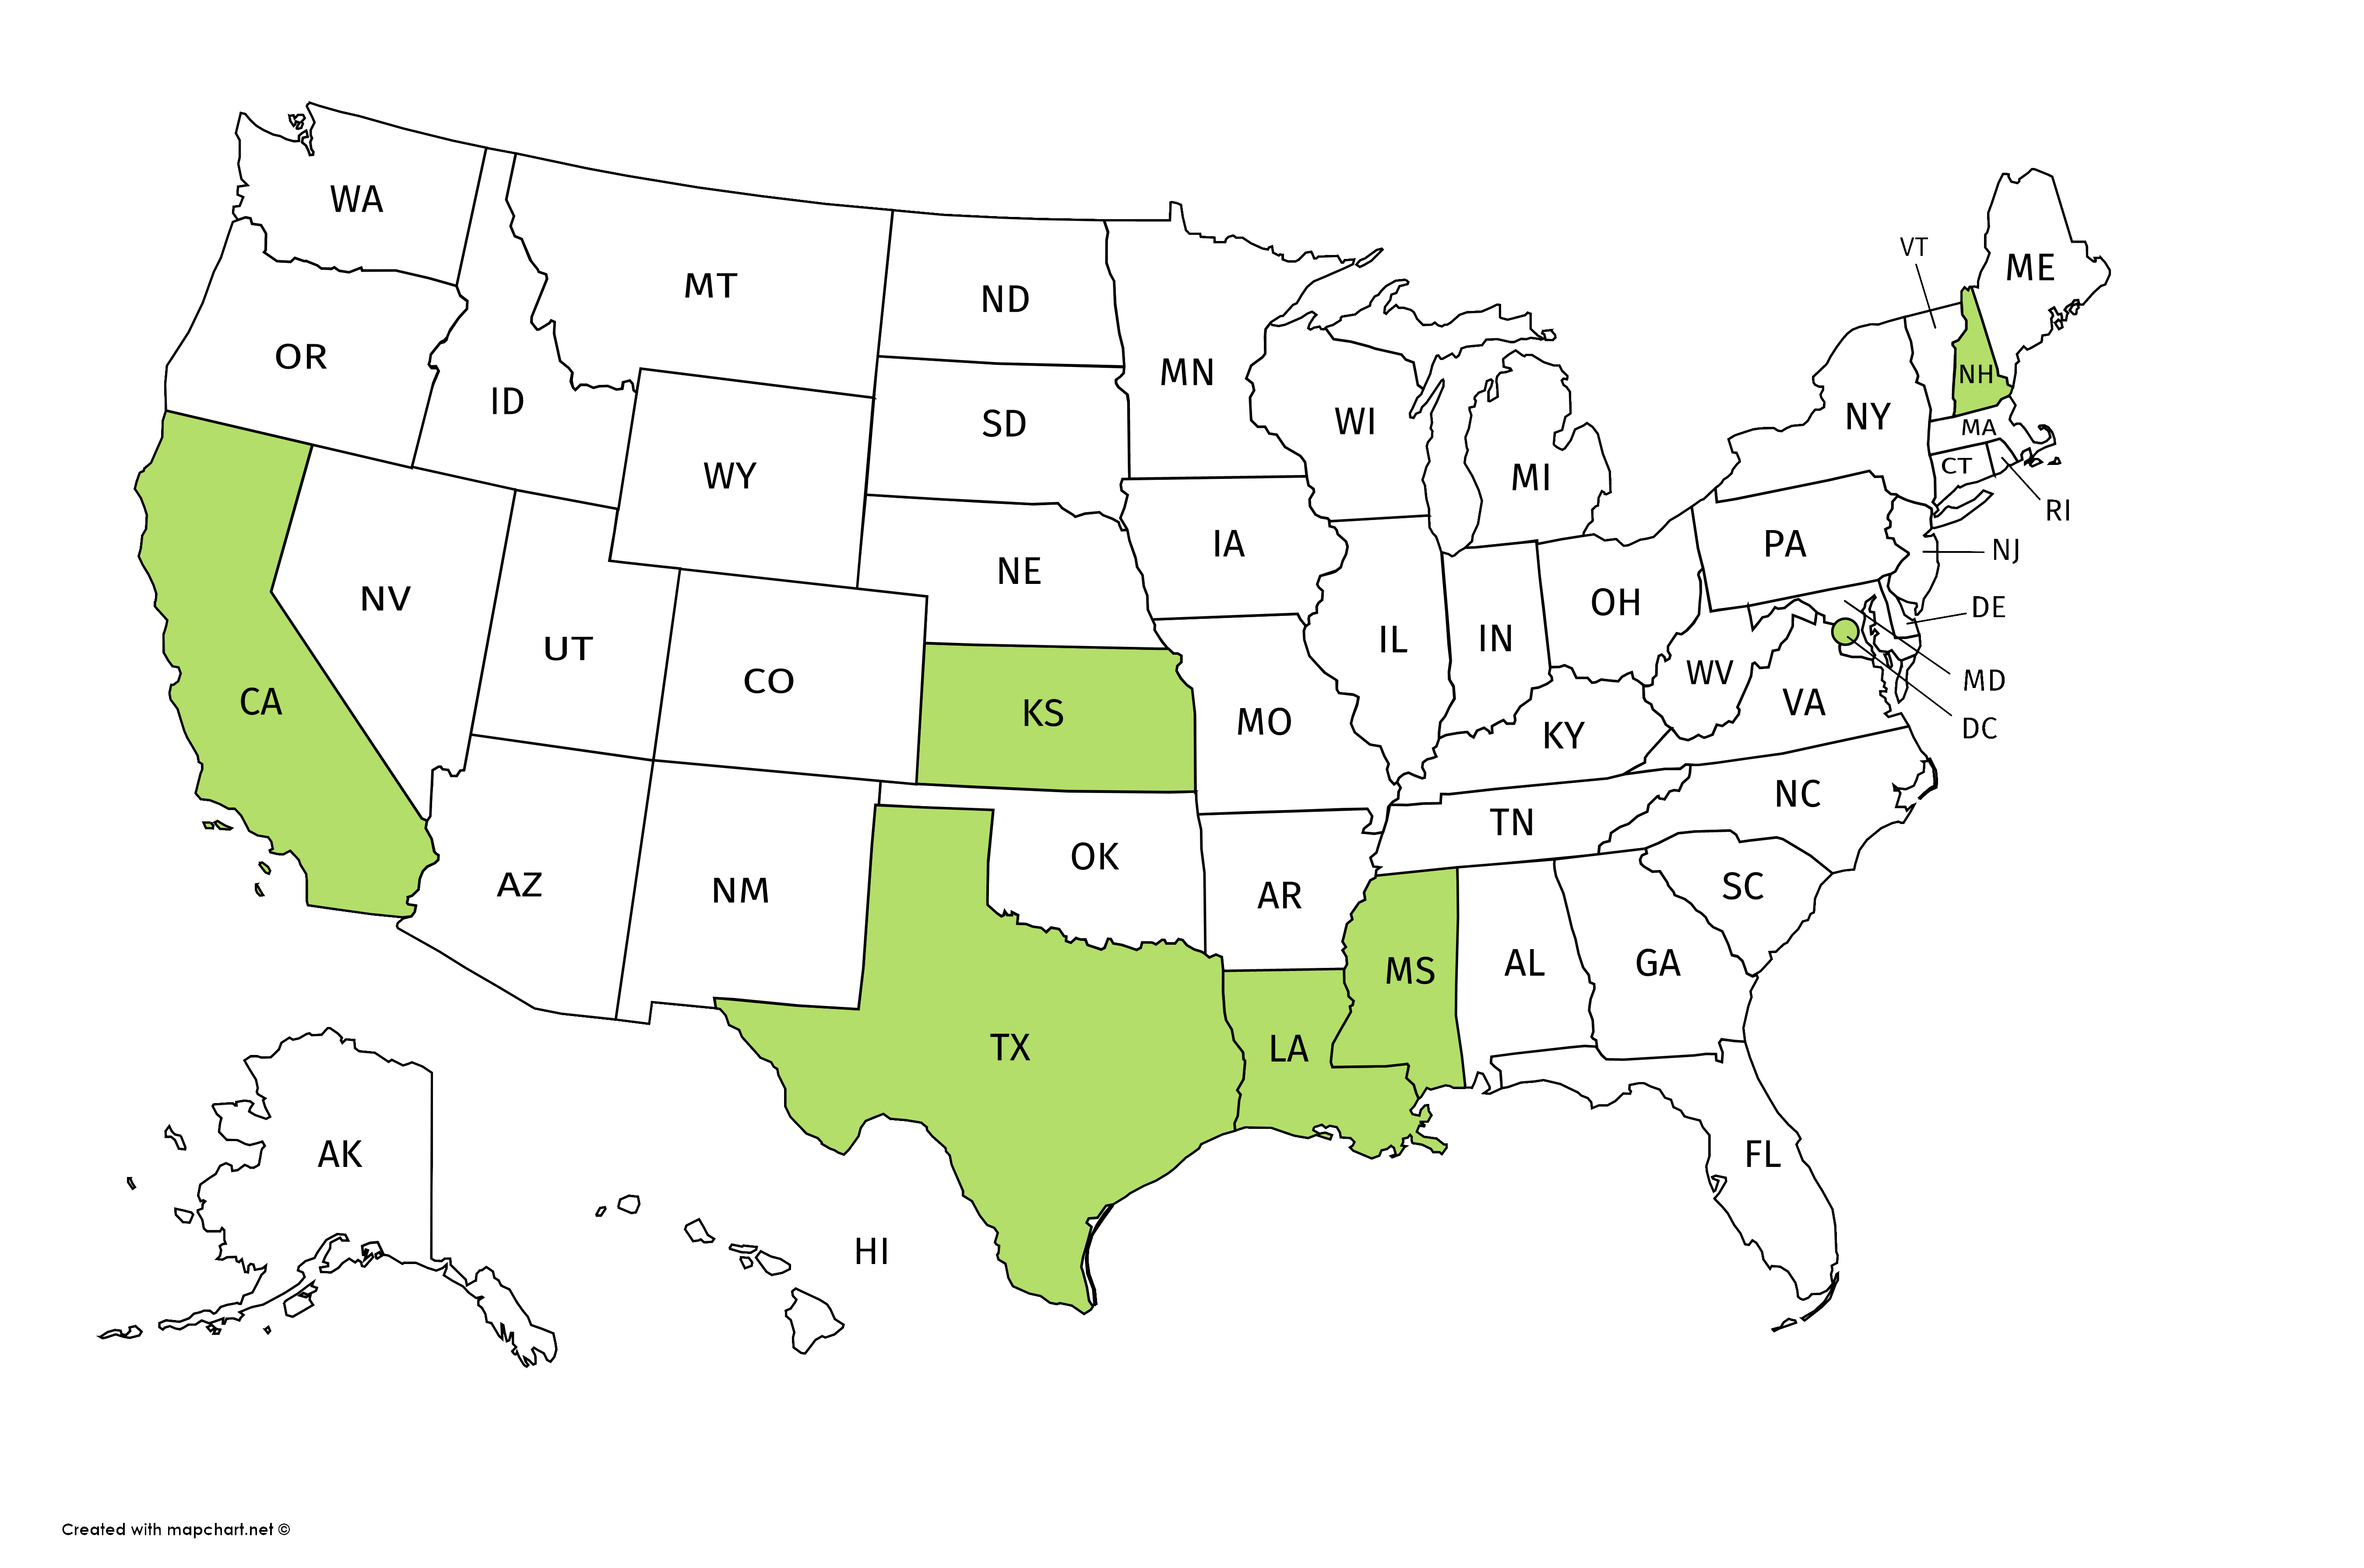

National Conference of Women’s Bar Associations
Houston adopted Food from the Bar in 2016.

Slide 19
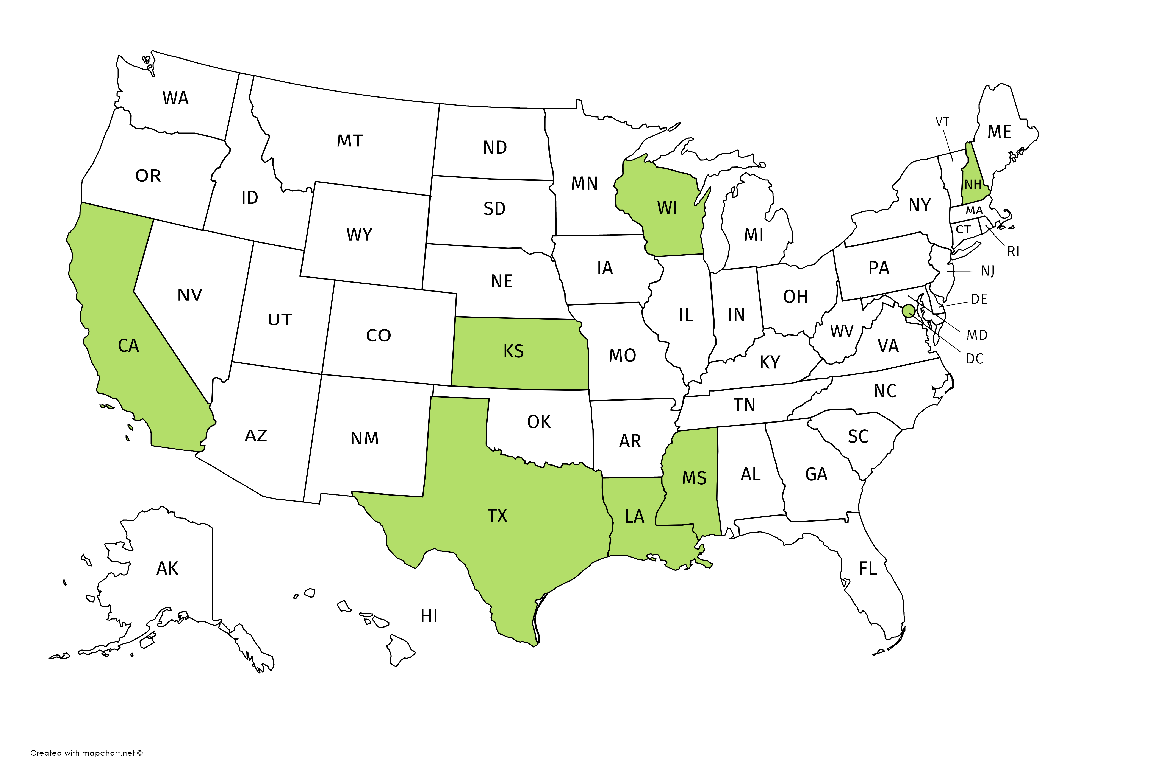

National Conference of Women’s Bar Associations
Milwaukee, WI started a Food from the Bar program in 2016

Slide 20

National Conference of Women’s Bar Associations
Galveston, TX also began its program in 2016

Slide 21

National Conference of Women’s Bar Associations
Other California cities:
Sacramento
Alameda County
Marin County

Slide 22

National Conference of Women’s Bar Associations
Orange County, CA is the latest program. It began in 2017.

Slide 23




National Conference of Women’s Bar Associations
Join Us and Turn Your State GREEN!

Slide 24
How does it work?

Slide 25


National Conference of Women’s Bar Associations
Feeding America Food Banks

Slide 26
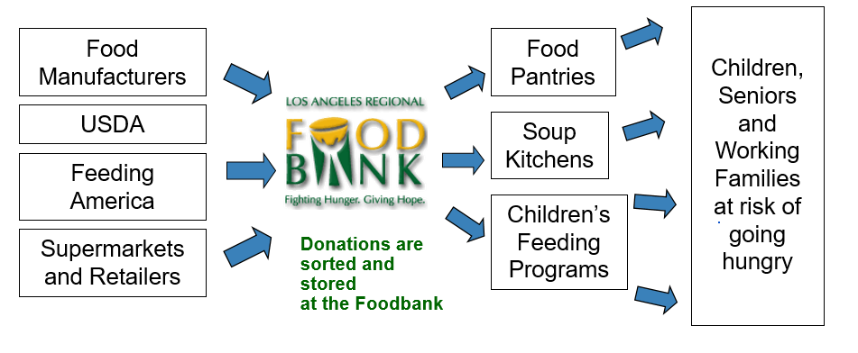
National Conference of Women’s Bar Associations
How Food Banks work

Slide 27
National Conference of Women’s Bar Associations
Partnering with Feeding America Food Banks
Track record, experience, support
T

Slide 28
Why adopt Food from the Bar?

Slide 29
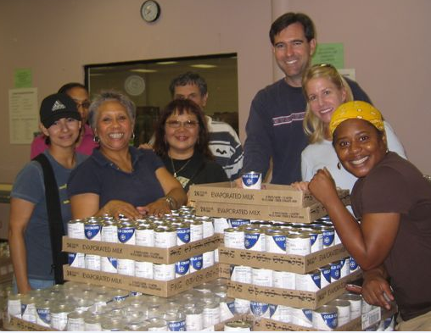
National Conference of Women’s Bar Associations
Why Adopt Food from the Bar?
Builds Community

Slide 30
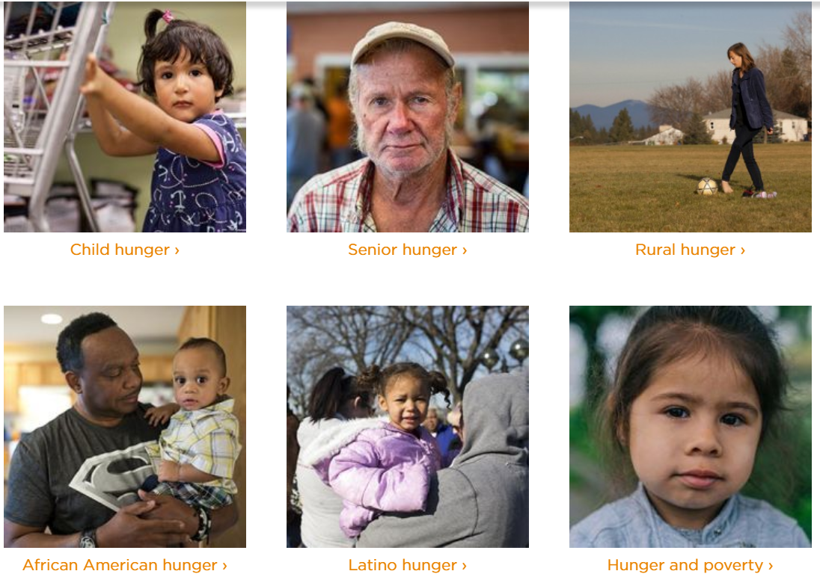
National Conference of Women’s Bar Associations
Why Adopt Food from the Bar?
Apolitical
nonsectarian

Slide 31

National Conference of Women’s Bar Associations
Why Adopt Food from the Bar?
Improves Image of Lawyers and Helps Community
Milwaukee, WI: 2017 = $23,112 (65% increase from 2016)
Houston, TX: 2018 = $200,519
SF-Marin County: 2018 =

Slide 32
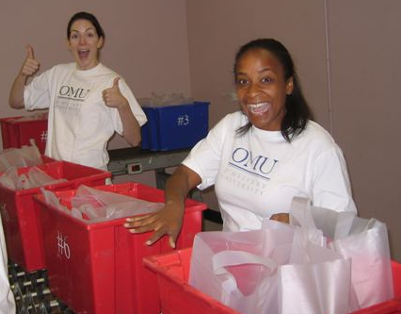
National Conference of Women’s Bar Associations
Why Adopt Food from the Bar?
Fun and Rewarding!

Slide 33
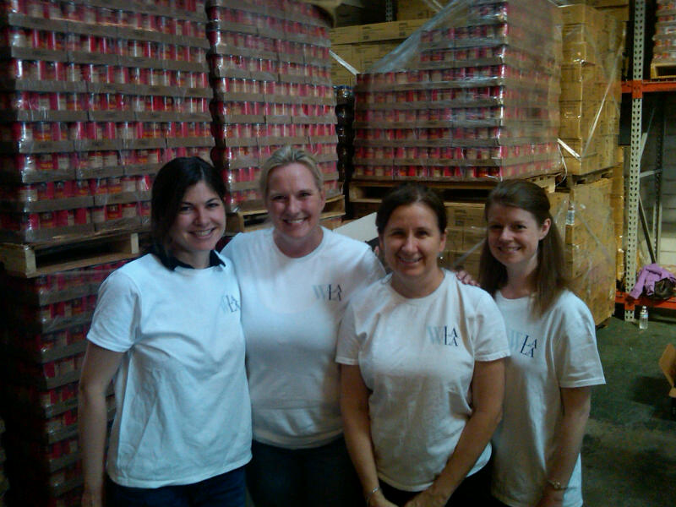
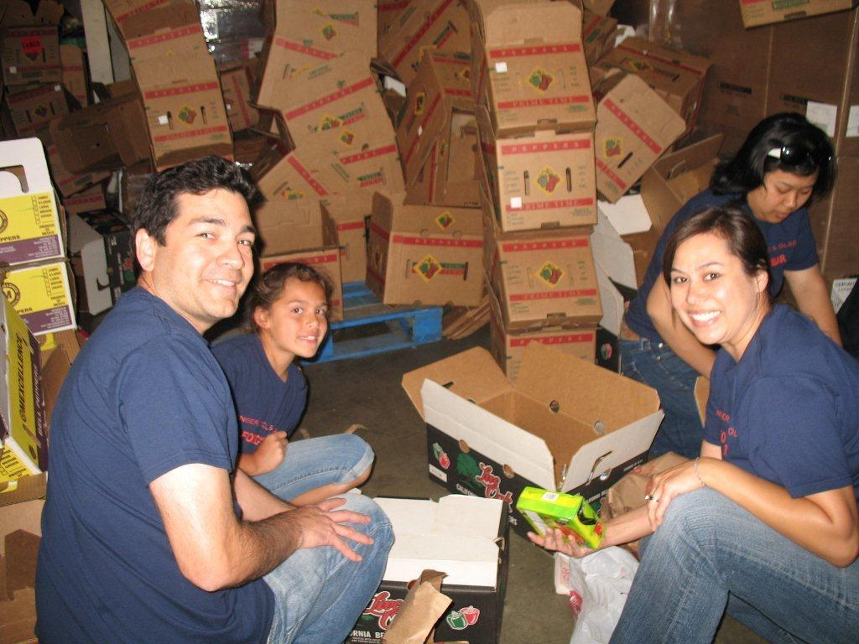
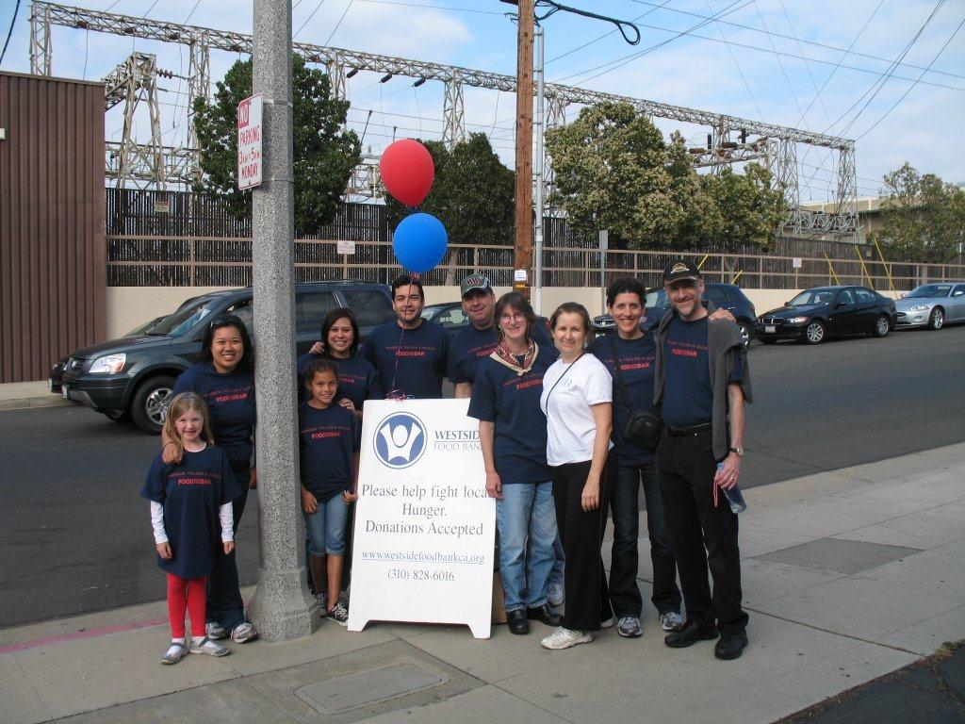
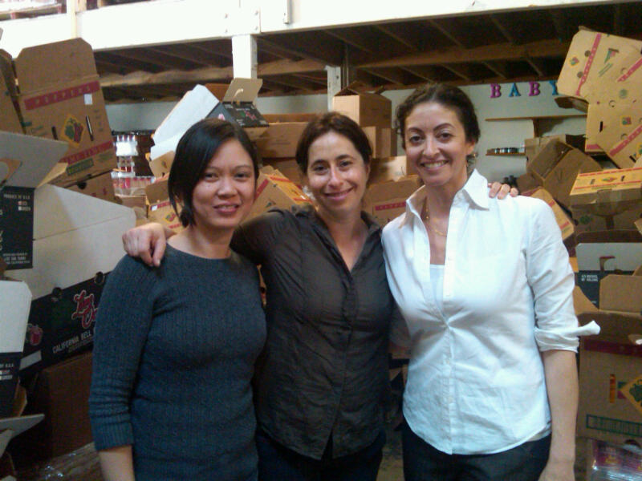
National Conference of Women’s Bar Associations
Volunteer Experiences
https://www.youtube.com/watch?v=KHsDwVbhLyc

Slide 34
How To Get Started

Slide 35
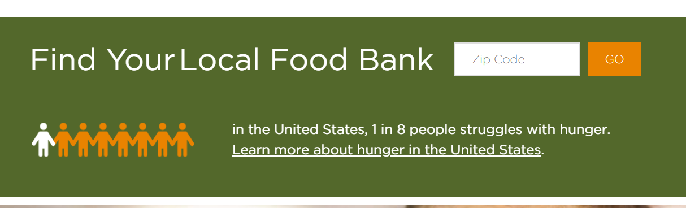
National Conference of Women’s Bar Associations
Find Your Local Feeding America Food Bank
www.feedingamerica.org/
www.feedingamerica.org/find-your-local-foodbank

Slide 36
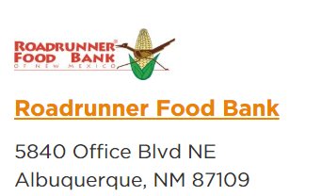
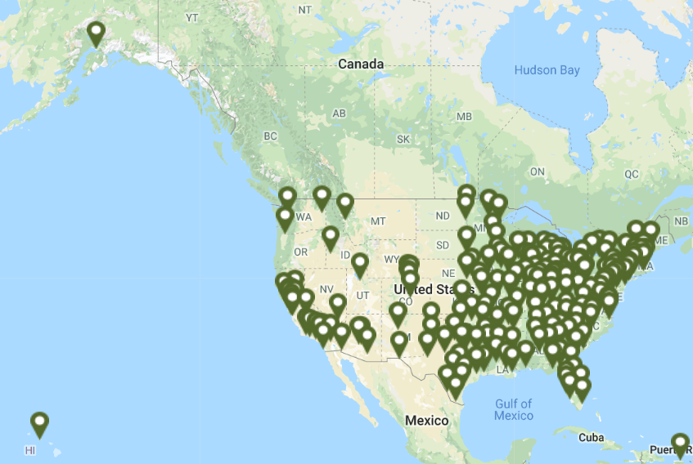

National Conference of Women’s Bar Associations
Throughout the United States

Slide 37

Partner with Others
National Conference of Women’s Bar Associations
Including Staff is Key

Slide 38
National Conference of Women’s Bar Associations
Organizational Basics
Reach Out To Food Bank and Local Bar Leaders
Have organizational meeting/call
Plan ahead
Set length of campaign
Set goals for campaign
Solicit Participants (Partner/Admin Liaison)
Publicize
Have Fun With It!

Slide 39
What are the keys to a successful program?

Slide 40
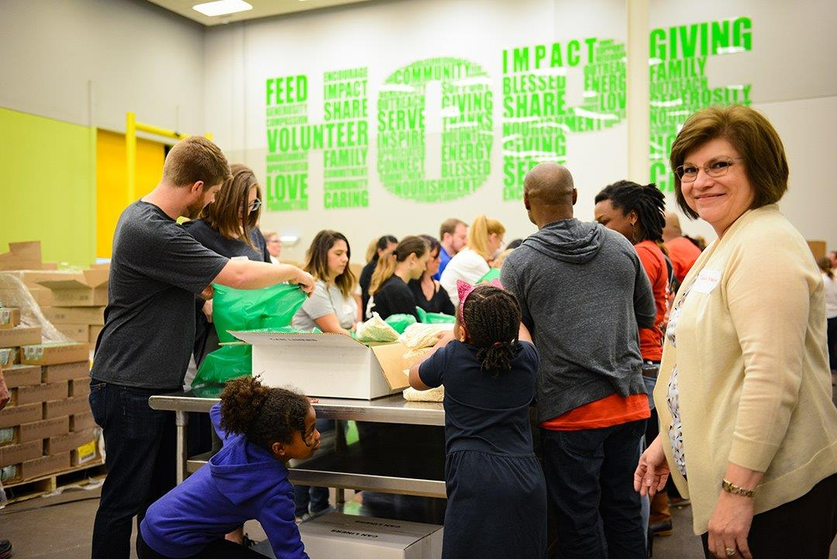
National Conference of Women’s Bar Associations
Be
Inclusive
Get staff, students and families involved!

Slide 41
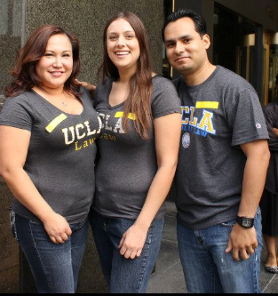
National Conference of Women’s Bar Associations
Seek out partners

Slide 42
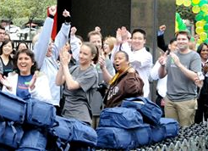
National Conference of Women’s Bar Associations
Have a
Kick-Off Event
Invite your Community and Start Strong

Slide 43
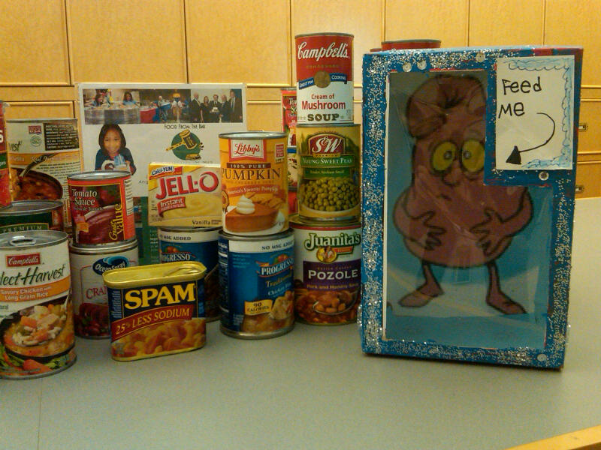
National Conference of Women’s Bar Associations
Make it
Easy
Create Food Drop-Off Points in High-Traffic Areas

Slide 44
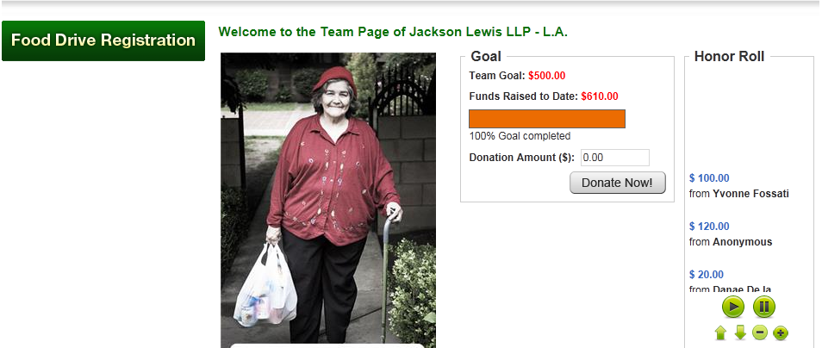
National Conference of Women’s Bar Associations
Make it
Easy
Allow for Online Donations or Payroll Deductions

Slide 45
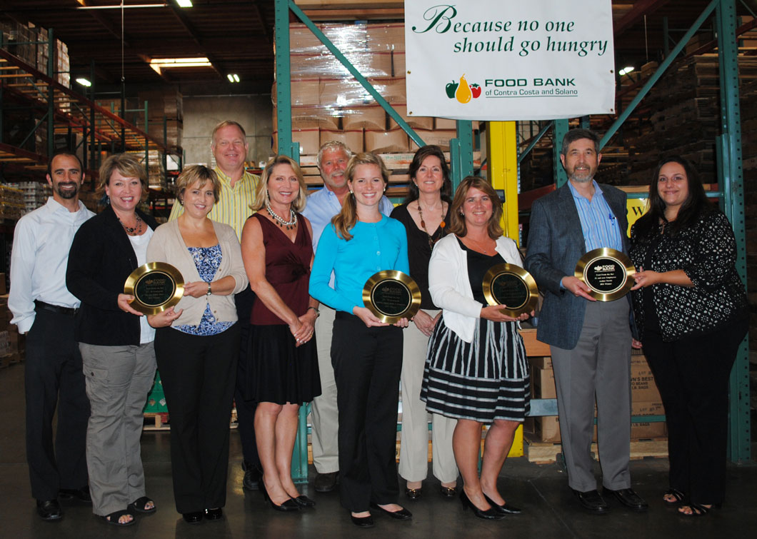
National Conference of Women’s Bar Associations
Give Out
Awards
Foster a healthy competition

Slide 46
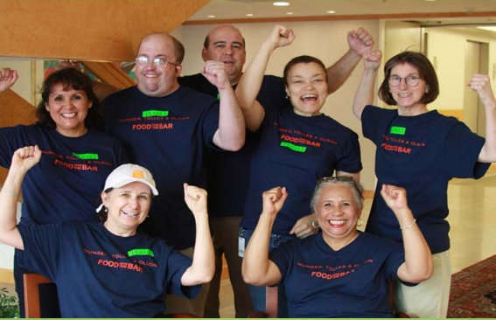
National Conference of Women’s Bar Associations
Have Fun
and
Get Creative

Slide 47
How to Make FFTB Fun!

Slide 48
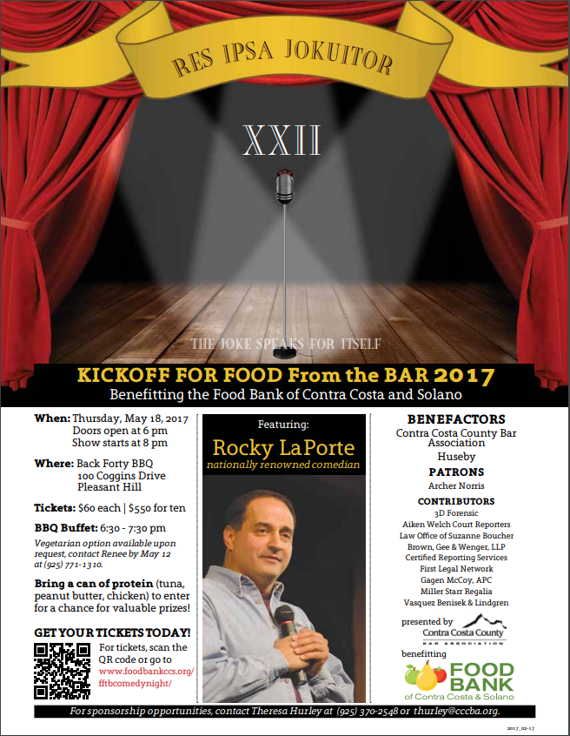
National Conference of Women’s Bar Associations
Contra Costa County Bar Association hosts an annual
Comedy Night
to kickoff their Food from the Bar program.
Creativity is key
Incentivize
Food Donations as part of your Event

Slide 49

Hold a Bake Sale

Slide 50
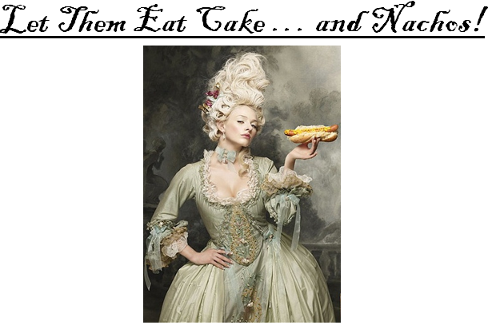
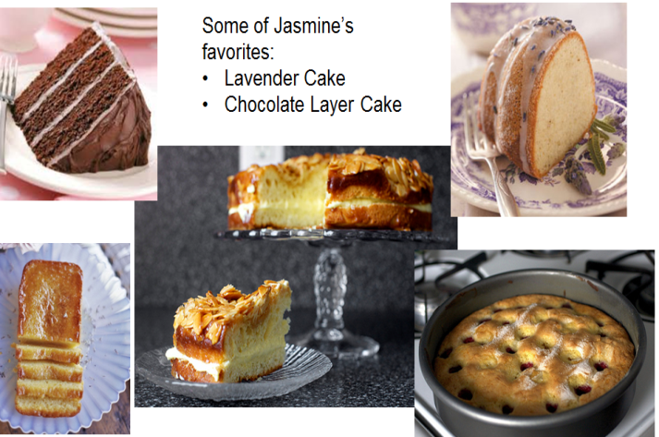
D s
National Conference of Women’s Bar Associations
Food Related Specialties

Slide 51

“Casual for a Cause”
Day
Allow employees to donate $5 to wear jeans on a day during the week.

Slide 52

Bring Your Pet to Work
Allow employees who donate to bring their pets to work for an afternoon.

Slide 53
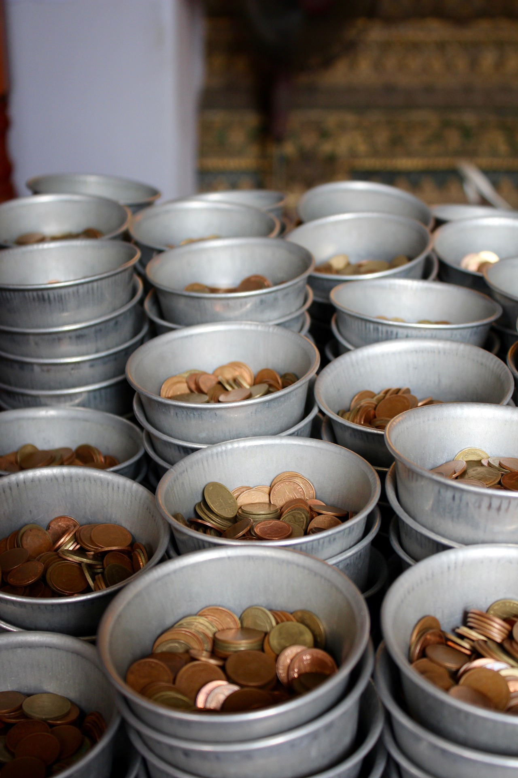
Start a Coin Drive
“Coins for A Cause”

Slide 54

Throw a Game Night

Slide 55


National Conference of Women’s Bar Associations
Doggo…
You…
Offer a
Silent Auction
With No-Cost Items
…loves walks in the park, tug of war, and cuddles.
Come ready to bid and spend an afternoon hour with Doggo!
…are over caffeinated, light-deprived, and in need of fresh air

Slide 56

National Conference of Women’s Bar Associations
Auction of Paid Day Off

Slide 57

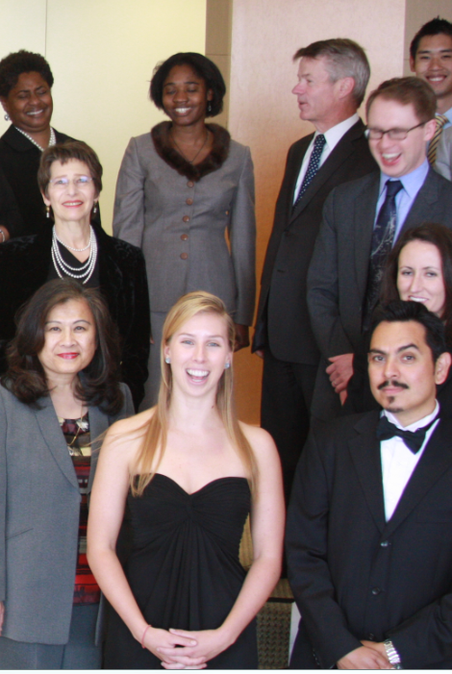
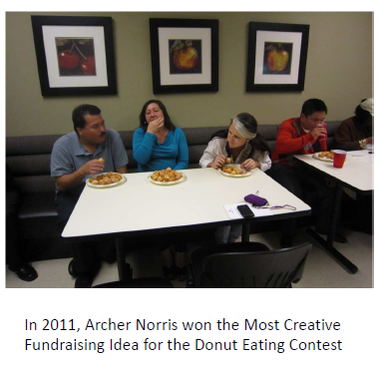
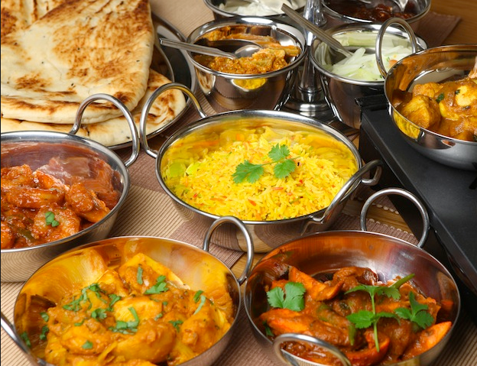
National Conference of Women’s Bar Associations
Have Fun
and
Get Creative

Slide 58


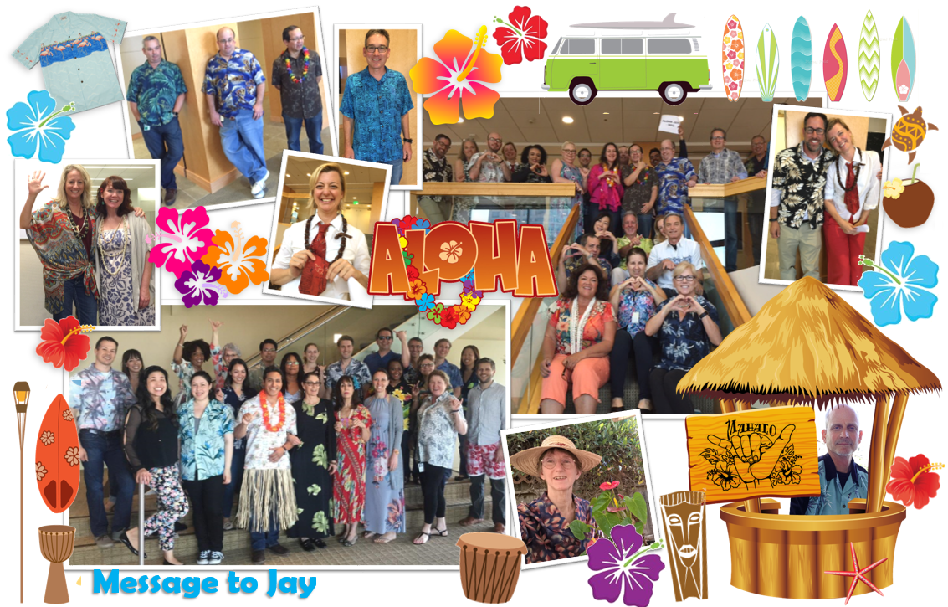
National Conference of Women’s Bar Associations
Have Fun
and
Get Creative

Slide 59
BE THE DIFFERENCE

Slide 60
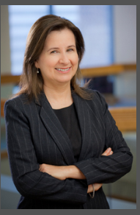
How Do I Get More Information?
Questions?
Contact
Kathleen McDowell
350 South Grand Avenue
50th Floor
Los Angeles, CA 90071-1560
213-683-9134
Kathleen.mcdowell@mto.com

